Slide 1
Relationships and Values Lesson 2

Slide 2
Objectives and outcomes
In this lesson we will explore the role of the media in shaping expectations around relationships, how to critically assess media messages and consider our role in challenging media narratives.
At the end of this lesson, I will be able to:
describe ways in which the media may influence expectations around relationships in both positive and negative ways.
share ideas on how the media can take a productive role in promoting healthy relationship expectations.
take action to minimise negative influences from the media and encourage responsible media representations of relationships.

Slide 3
Ground rules
Notes:
Teacher notes
To create a climate of trust for safe and effective learning, ensure that ground rules are established or revisited at the beginning of this lesson. Please refer to ‘A safe environment for learning’ in the teaching guidance for more details.

Slide 4
Does the media influence young people’s views about relationships? In what way?
Notes:
Teacher notes
Ask what students understand by the term ‘media’ – ensure understanding that ‘media’ in this context is used to describe all forms of mass communication, eg. internet, TV/film, advertising, news, social media
Students to discuss with a partner and then take responses as a whole class.

Slide 5
In September 2021, a group of young people gave their views on the portrayal of relationships in the media.

Slide 6
What percentage of young people agreed that the media influences their peers’ expectations of relationships?
61%
FASTN/Survation polling, 2021
Notes:
Teacher notes
Reveal the question and ask students to guess the statistic from research around the media and relationships. Reveal the statistic.
Ask: how does this fit with your earlier discussions? Do you agree/disagree? In what way might it do this? Encourage students to also reflect on discussions about values in the last
lesson.

Slide 7
Agree or Disagree?
Notes:
Teacher notes
Run the continuum activity. Hand out the worksheets and direct students to complete. Ask each student to share their responses with a partner – how are their
views similar or different to their partner? Why do they think this is?
The continuum can also be done as a whole class. Stick the continuum poster sheets around the room. Ask students to make their mark using a pen on each one
according to where they stand. Discuss the responses as a whole group. Explore how responses differ across the class and why this might be.
Ensure young people know that this is about values and attitudes, not right or wrong – it is ok to have different views. Remind students of the group agreement if
needed.

Slide 8
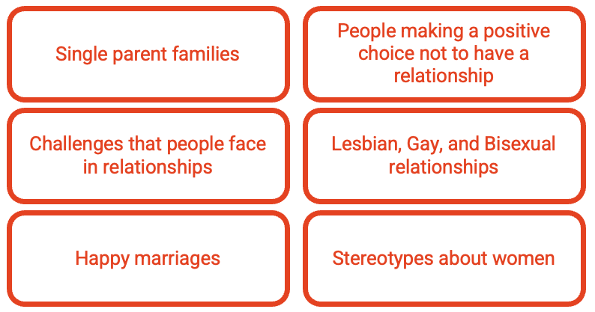
Representation in the media
Look at the ‘media representation cards’ – how often do you see each of these in the media? Sort into the categories of ‘Often’, ‘Rarely’, ‘Never’
Notes:
Teacher notes
Split into small groups and give each group a set of ‘media representation cards’ and ask them to sort into the categories of Often/Rarely/Never as relevant to what they experience from the media. Ask students to consider if there are any other people or aspects of relationships that they see often, rarely or never represented in the media – they can add these in.
Hold a class discussion to explore responses to the activity. What are the similarities and differences? Why?
Explore the impact of lack of, and over-representation of some groups/relationships. What influence could this have on young people’s views and values around relationships
In the discussion, draw out whether students gave any consideration to whether the representation of these groups is positive or negative. You may choose to give some more time for pupils to consider this and feedback
You may want to give more specific examples for students to consider, for instance, the popularity of programmes featuring dating agencies for disabled people – what message does this send about disabled people and relationships?

Slide 9
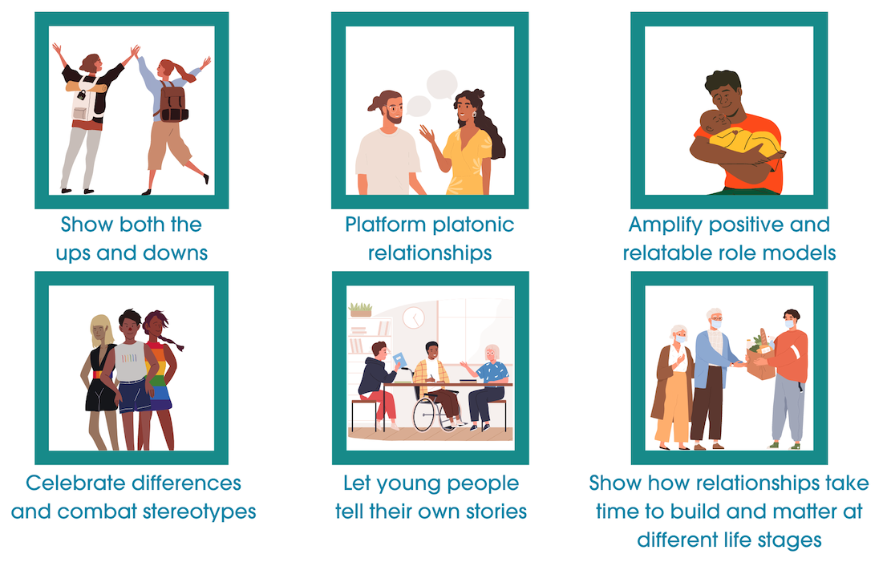
Reframing relationships
Which do you feel is most important?
Notes:
Teacher notes
Briefly go through each point to check understanding. Explain that this graphic shows young people’s views on how the media can better represent relationships for young people based on research from Reframing Relationships.
Ask students to discuss in groups and prioritise from 1 to 6 in order of which they feel are most important.
Hold a class discussion to explore similarities and differences between the groups. Stress that our different opinions are what make us unique and that arguably all of these are important, but individual people may have different views.
Ask: In relation to positive representations of relationships - what would you like to see more of in the media, what would you like to see less of?

Slide 10
Rights
Article 12 (respect for the views of the child)
Every child has the right to express their views, feelings and wishes in all matters affecting them, and to have their views considered and taken seriously. This right applies at all times…
Article 17 (access to information from the media)
Every child has the right to reliable information from a variety of sources, and governments should encourage the media to provide information that children can understand. Governments must help protect children from materials that could harm them.
Notes:
Teacher notes
Explain that the UN convention on the Rights of the Child specifies how children should be treated. The two articles or rules on this slide relate to how young people are heard, and represented, by the media.
Ask: Do you feel that the media listen to the views of young people? How well does the media provide accurate and reliable information for young people?

Slide 11
How can young people change the way the media represents relationships and/or minimise the influence of negative representations?
Notes:
Teacher notes
Ask: how can young people change the way the media represents relationships and/or minimise the influence of negative
representations? Take responses.

Slide 12
Agents for change examples
Filter negative content on social media
Give feedback to media organisations
Reflect regularly on your own values around relationships
Recognise stereotypes and challenge them
Take breaks from the media
Accept and celebrate diversity - learn more about relationship challenges facing particularly groups.
Notes:
Teacher notes
Ask: Which of these would have most impact?

Slide 13
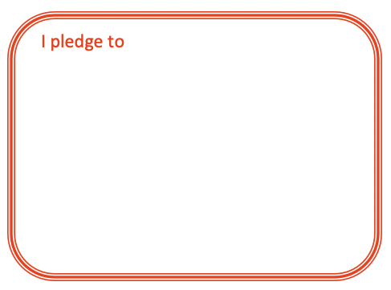
Pledges
Notes:
Teacher notes
Ask each student or groups of students to pledge one thing they will do to challenge and/or lessen negative influences from the media.
Ask students to carry out their pledges as a project within class or as a homework task.
There are a range of ways that you could encourage students to take action either during class or as a homework activity. Some examples are given below:
- Writing to a media outlet to either praise or ask for change.
Taking a leadership role in a discussion about how to improve representation of relationships in school media
Inviting a local journalist to talk with them about their role in tackling abusive relationships in their community
Gather views from other students in school about representations of relationships in the media and present to local media outlets or nationally via social media.
.

Slide 14
How does the media influence young people’s views about relationships?
Notes:
Teacher notes
Return to the opening brainstorm question ‘How does the media influence young people’s views about relationships?’ – is there anything they would add to this? Ask students to write any additions in a different coloured pen.
The Agents for Change pledges and actions can be used to evidence how young people have applied their learning from lessons 1 and 2.

Slide 15
Need to know more?
Brook: provide advice on relationships, and on sexual health and wellbeing
www.brook.org/topics/relationships
Respect not Fear: website for young people about healthy relationships
respectnotfear.co.uk
Childline: a free, confidential service for children and young people under 19 to talk about any issue they need to.
www.childline.org.uk
Young Minds: information about mental health and wellbeing
www.youngminds.org.uk
Relate: relationships support and counselling
www.relate.org.uk/relationship-help/help-children-and-young-people
Notes:
Teacher notes
Mention any named pastoral care staff or support mechanisms in school.
Ask if pupils have any outstanding questions about this lesson or any issues it raised. Direct them to the anonymous question box if necessary.

