Slide 1
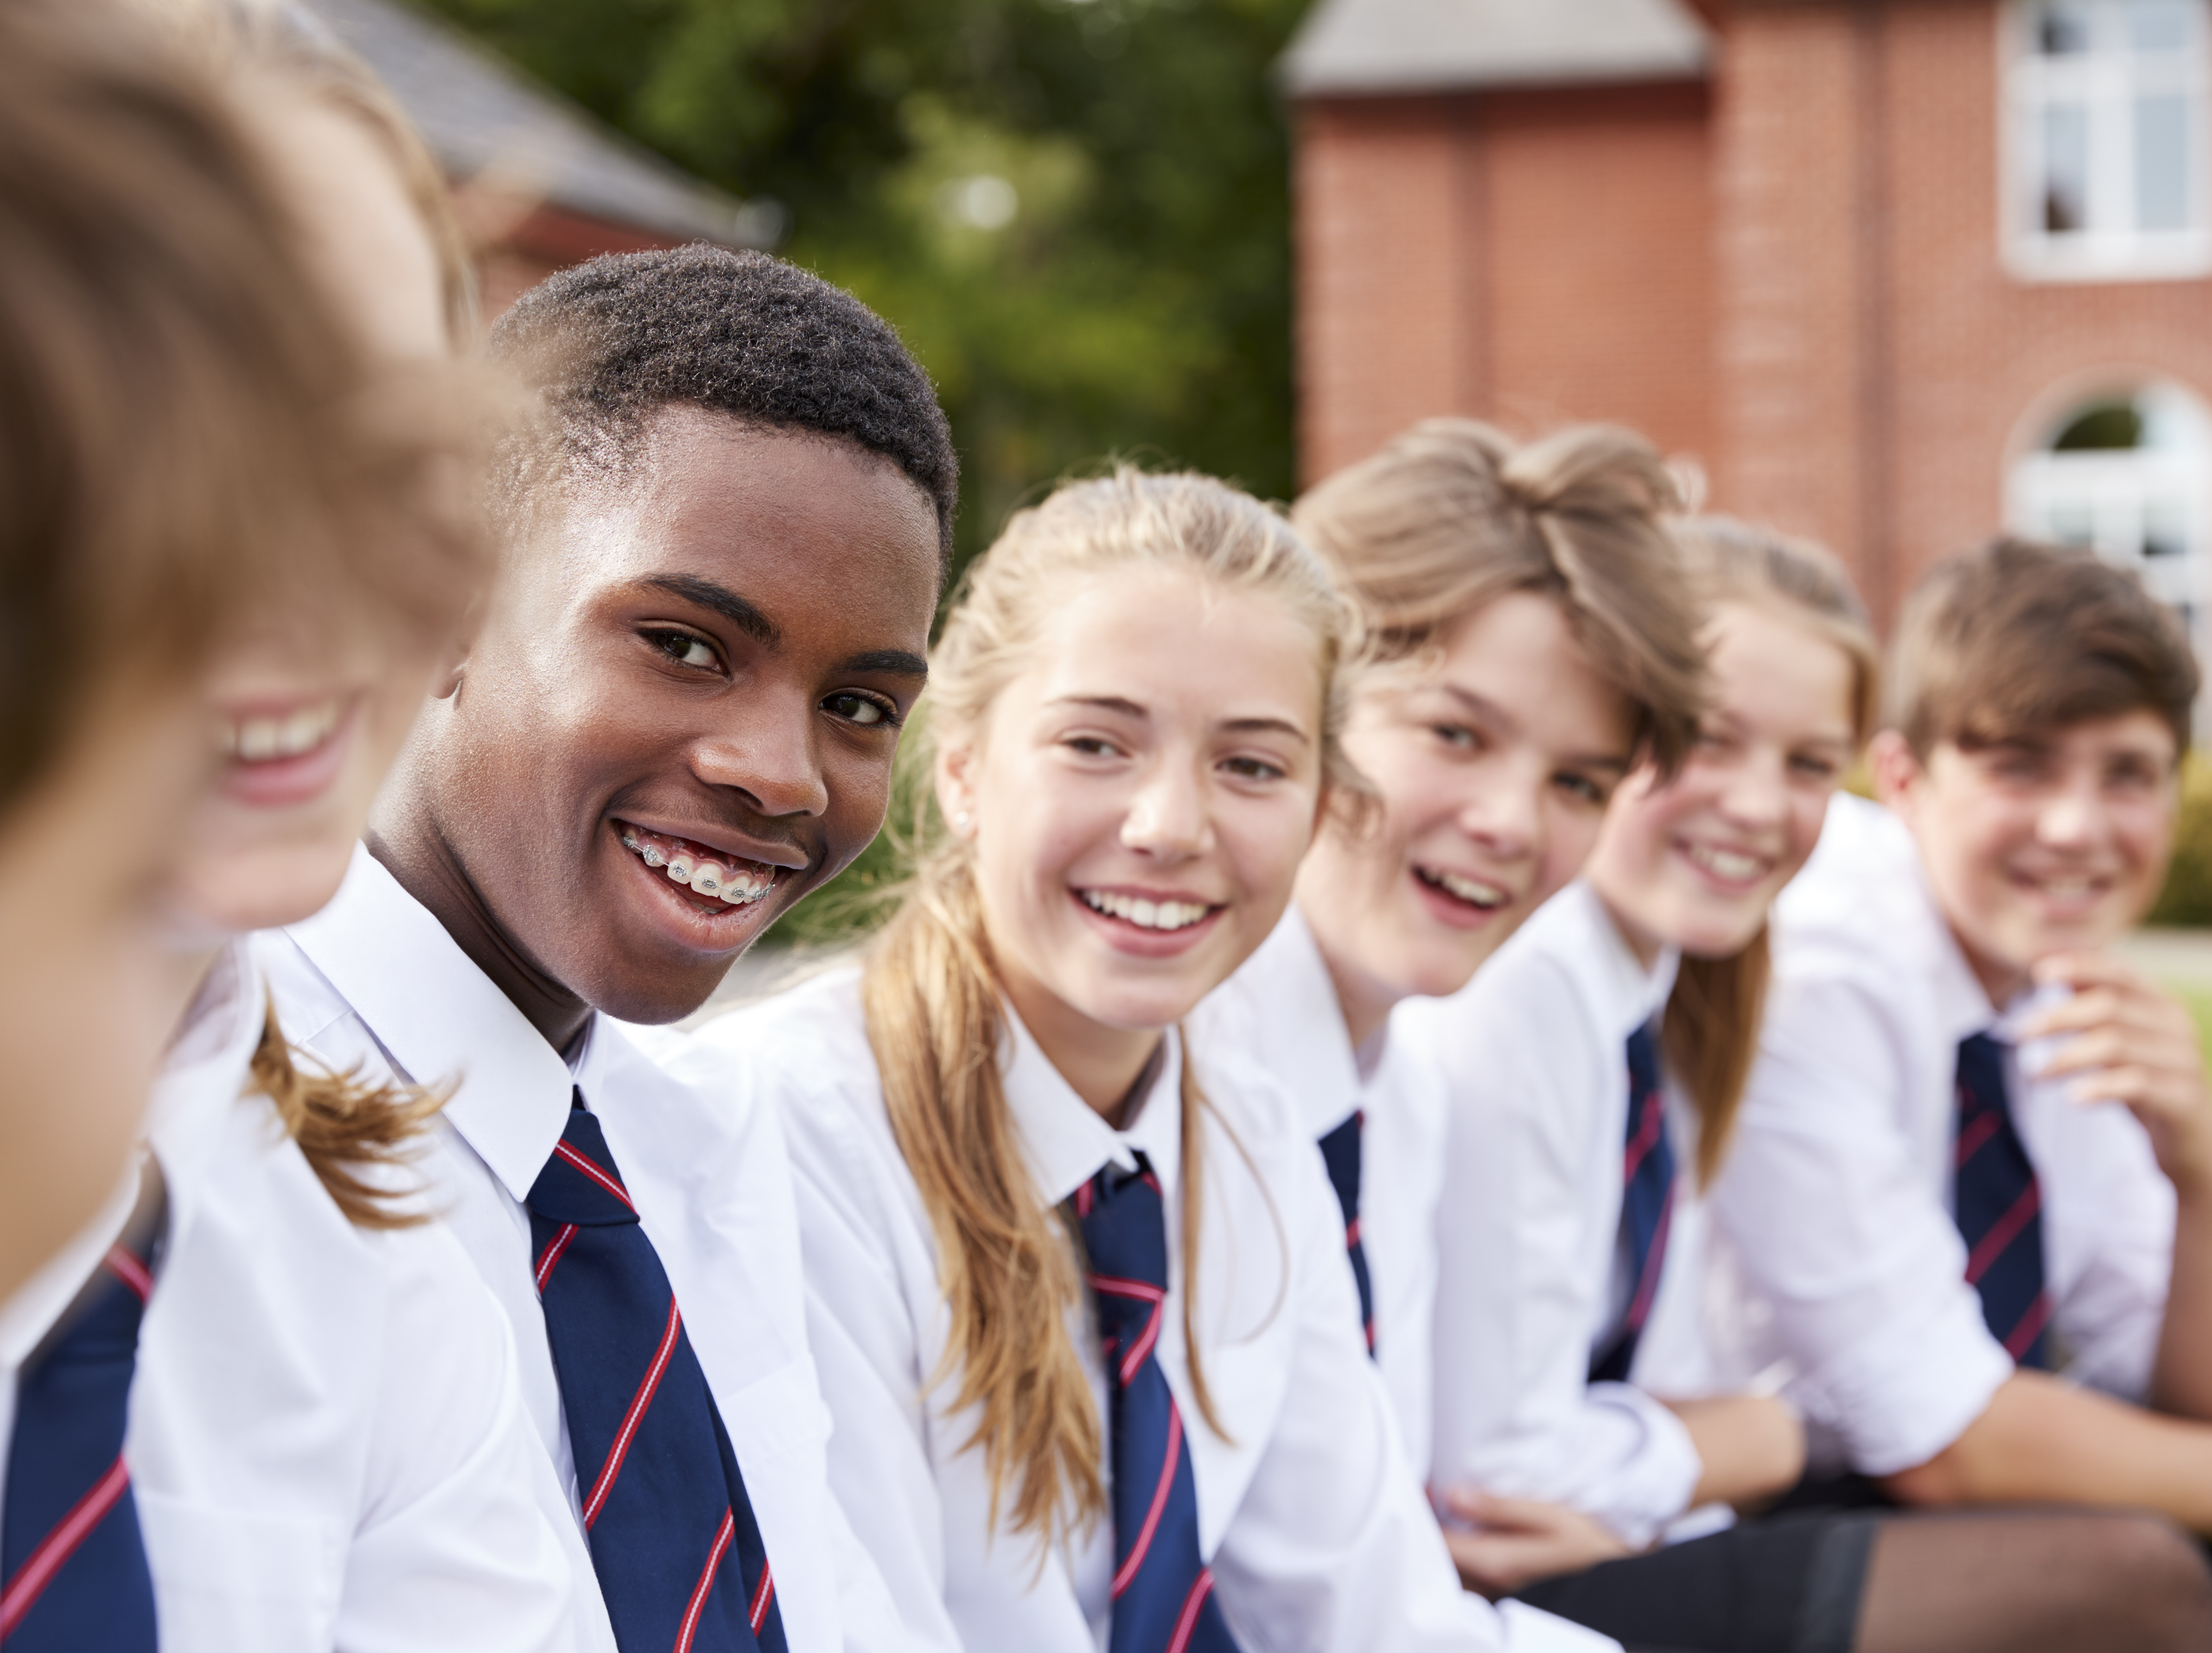
Relationships and values Lesson 1

Slide 2
Objectives and outcomes
In this lesson we will explore our own and others’ values around relationships, how these are formed and what may influence them.
At the end of this lesson, I will be able to:
describe my own values around relationships and how these are similar and/or different to my peers
explain what influences our values around relationships and how these may change through life
identify my own relationship goals

Slide 3
Ground rules
Notes:
Teacher notes
To create a climate of trust for safe and effective learning, ensure that ground rules are established or revisited at the beginning of this lesson. Please refer to ‘A safe environment for learning’ in the teaching guidance for more details.

Slide 4
Equality
Sharing
Trust
Respect
Empathy
Aspiration
Fairness
Kindness
Notes:
Teacher notes
Ask students to look at the words on the slides and choose one that feels important to them – take some examples.
Explain that these words represent some example of human values.

Slide 5
What are values?
Notes:
Teacher notes
Students to discuss with a partner and then take responses.

Slide 6
Values are the beliefs we hold about what is important, what matters most to us in life. They guide our decision-making and help us to assess the choices we have made.
Notes:
Teacher notes
Ask students if they can think of any other values than those on slide 4, prompt as needed, eg. honesty, friendship, security.

Slide 7
Use these questions to identify one or two values that you have:
Think of a time when you were happy:
Who were you with?
What were you doing?
What was happening?
Think of a time when you were feeling proud:
What made you feel proud?
Who shared in your pride?
What was happening?
Notes:
Teacher notes
Ask students in pairs to look at the questions on slide 6. How might these questions help someone to identify
their values?
Give students the option of using the questions to identify a couple of their own values, either through discussion
or internal reflection.
Invite responses if students want to share.
Ask students:
Where do our values come from?
How do these values influence our lives?
Offer support to any students who find it difficult to identify values.
.

Slide 8
Some examples of values in relationships
“I think honesty is the best policy.”
“I’d like a relationship where we are both equal.”
“I really value commitment in relationships.”
“Being able to talk openly about feelings is most important.”
Notes:
Teacher notes
Explain to students that someone’s values often guide their wants, needs and behaviour in relationships. Talk
through how our values might guide or impact on our behaviour. Ask students to think to themselves about how
the values they identified have impacted on their behaviour in the past.
Ask: How might the values shown here impact on relationships? So, if person A values honesty, what would
they look for in a friend or partner? How could this value influence their behaviour in the relationship? What
would their expectations for a relationship be?

Slide 9
Conflicting values
Person A has values of loyalty and belonging.
Person A wants to spend time with a new group of friends who they have a lot in common with. They want to be liked by them.
Person A feels uncomfortable that they may hurt their friend but discovers that belonging to the new group may be more important to them than loyalty to their friend.
Person A knows that one of their existing friends doesn’t like the people in this new group.
Notes:
Teacher notes
Talk through the scenario. Explore how our values do not always entirely align, they may conflict, and we may
prioritise one value over another in some situations.
Ask: Can you think of any other examples where someone’s values might conflict?

Slide 10
What values are behind the quotes?
Have a look at your quote, what values are important for this person?
Notes:
Teacher notes
Working in small groups, give each a quote with the list of relationship values.
Firstly, ask if there are any values that need explaining.
In groups, direct students to discuss what values they think lie behind their given quote. Circle any that apply. If time allows, groups can share their sheets and discuss whether they agree or disagree with the other groups’ ideas.
Share each group’s responses with the class and ask for any additional contributions.
Ask students to consider which of the values listed are important for them.
Stretch – for anyone that has finished quickly – ask them to write their own quote about relationships

Slide 11
Who or what influences our values around relationships?
Notes:
Teacher notes
Lead a brainstorm of all the things that might influence someone’s values around relationships. If any of the
following influences haven’t been mentioned, add them in: family, friends, social media, TV/film, learning/school,
siblings.
Ask students to plot the influences on the magnet worksheet as to how strong or not they feel the influence is.
Remind them that they may not all agree, they may have to compromise.
Discuss responses as a class. What are the similarities and differences between groups?
Explore those that students have identified as exerting most influence – is this a positive or negative influence?
Ask the students if they feel values around relationships change through life. How might a 40-year-old complete
this activity, would it look different?

Slide 12
Who or what has the biggest influence on our values at each stage?
Age 6
Age 14
Age 25
Age 40
Age 60
Notes:
Teacher notes
Ask: Do our values change through life? Who or what has the biggest influence at each stage? Why?
There are no right or wrong answers here, it is about opinion.
Explain that unlike feelings which can change often, values are more stable through life. This can make values a useful guide in relationships.
Pick out a few values, eg. trust, equality, responsibility – ask students if they feel these values are taught (learnt), caught (acquired, passed on) or both.

Slide 13
Relationship goals are:
what/how someone wants to be in a relationship
what someone aspires to in a relationship
Notes:
Teacher notes
Explain that not everyone will want to have a romantic or intimate relationship but in life most people will have
some sort of relationship, whether that be with a friend, a family member, a carer, a work colleague.

Slide 14
Relationship goals example
For someone who values honesty their goal might be:
I want a relationship where we can talk openly and honestly about our feelings.
Notes:
Teacher notes
Ask students to return to their relationship quotes sheet – what could be the relationship goals of the person
saying this? Fill in on the goal worksheet.

Slide 15
Relationship goals

Slide 16
What are my relationship goals?
Notes:
Teacher notes
Encourage students to reflect on their values and consider what sort of relationship goals they have now and/or in the future. Pupils to discuss with a partner and then take responses as appropriate. Ask students if they feel their goals may change as they progress through life. What might influence them?
Explain that not everyone will want to have a romantic or intimate relationship but in life most people will have some sort of relationship, whether that be with a friend, a family member, a carer, a work colleague.

Slide 17
Need to know more?
Brook: provide advice on relationships, and on sexual health and wellbeing
www.brook.org/topics/relationships
Respect not Fear: website for young people about healthy relationships
respectnotfear.co.uk
Childline: a free, confidential service for children and young people under 19 to talk about any issue they need to.
www.childline.org.uk
Young Minds: information about mental health and wellbeing
www.youngminds.org.uk
Relate: relationships support and counselling
www.relate.org.uk/relationship-help/help-children-and-young-people
Notes:
Teacher notes
Mention any named pastoral care staff or support mechanisms in school.
Ask if pupils have any outstanding questions about this lesson or any issues it raised. Direct them to the anonymous question box if necessary.

